Slide 1
Nemzetközi tapasztalatok és kihívások a nem hagyományos szénhidrogén kutatás területén
Hazai tanulságok
Bada Gábor
Operációs igazgató - Falcon Oil & Gas Ltd
Figyelő Konferencia - "Rétegrepesztés, avagy a gázkitermelés jövője"
Budapest, 2014. október 30.
Notes:
1

Slide 2
Falcon in a nutshell
Dublin
Head Office
Hungary: technical center,
Makó trough
N. Territory, Australia:
Beetaloo basin
South Africa:
Karoo basin
Falcon Oil & Gas Ltd. is a global energy company that is focused on acquiring, exploring and developing large acreage positions of unconventional and conventional oil and gas resources.
Falcon holds ~50,000 km2 (over 12.25M gross acres) in three major exploration projects in Hungary, Australia, and South Africa.
Head office in Dublin, Ireland; technical center in Budapest, Hungary
Falcon's shares trade in Toronto (TSX), London (AIM) and Dublin (ESM)

Slide 3
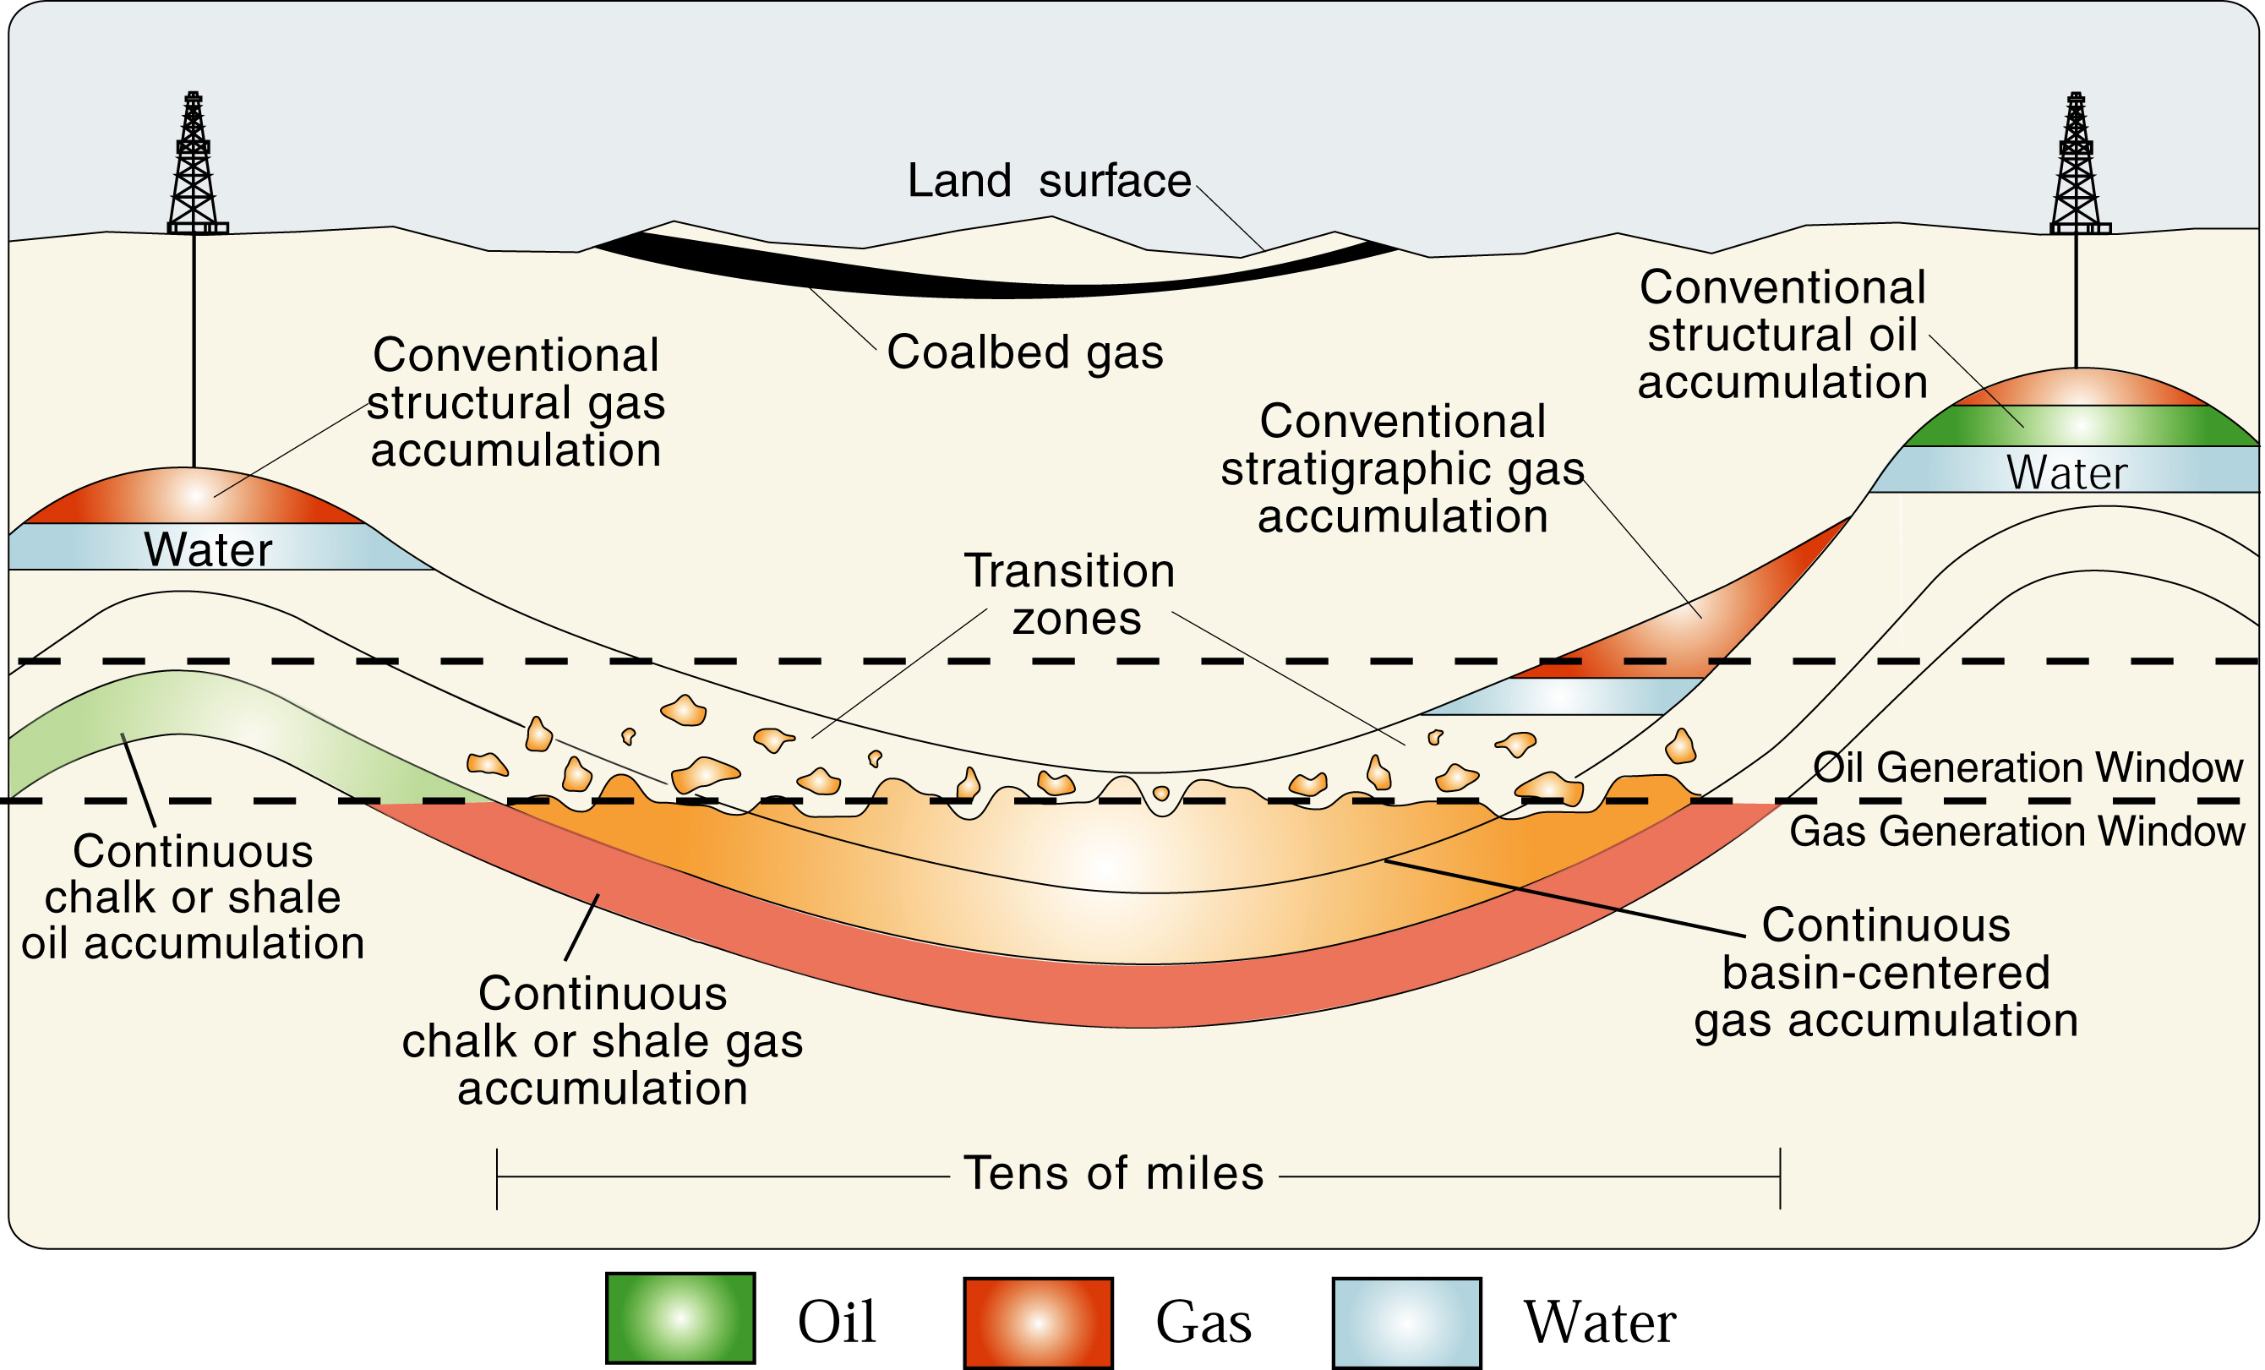
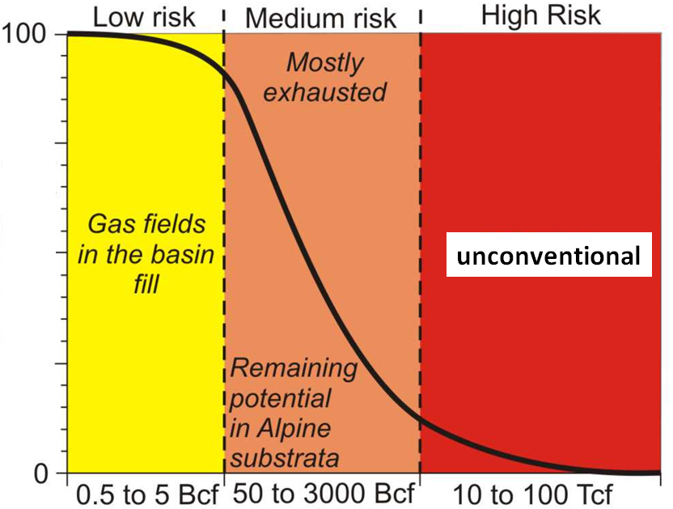
Unconventionals 101 - Opportunities vs. challenges
Principles
No traps but pervasive cells with areas of high productivity/recovery ("sweet spots")
'Stubborn'reservoirs - recovery usually low
Geology controlled, technology driven
Tight rocks - stimulation/fracking needed
Pollastro et al., 2003
Conventional:
low risk, low reward
The Opportunity:
- Huge in-place hydrocarbon volumes
- High risk/high reward petroleum systems
The Challange:
- Identify areas of high productivity
often referred to as "sweet spots"
- Crack the code and establish commercial flow rates
Probability of occurrance (%)
Unconventional:
high risk, high reward
In place volumes (in gas eq.)

Slide 4
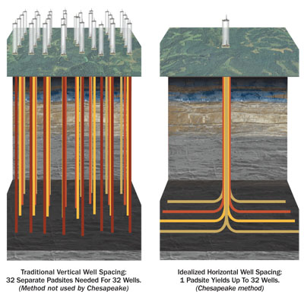
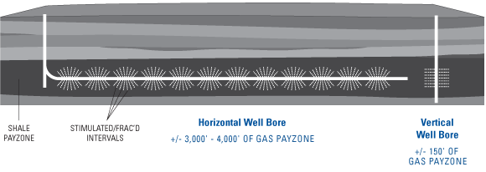
Unconventionals 101 - Geology controlled, technology driven
Technology is key
Multi-well pad approach
Technology is rock specific, tailored to local geology
Production enhancement by means of hydraulic fracturing, usually multi-stage
Horizontal drilling - reservoir exposure & drainage
Multi-well pad approach - reducing surface footprint (and costs)
Horizontal vs. vertical drilling & fracking
target reservoir
Pretty much 'conventional' technology -
improved tremendously,
used extensively

Slide 5
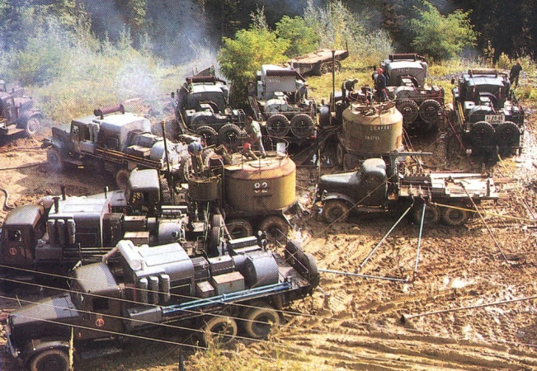
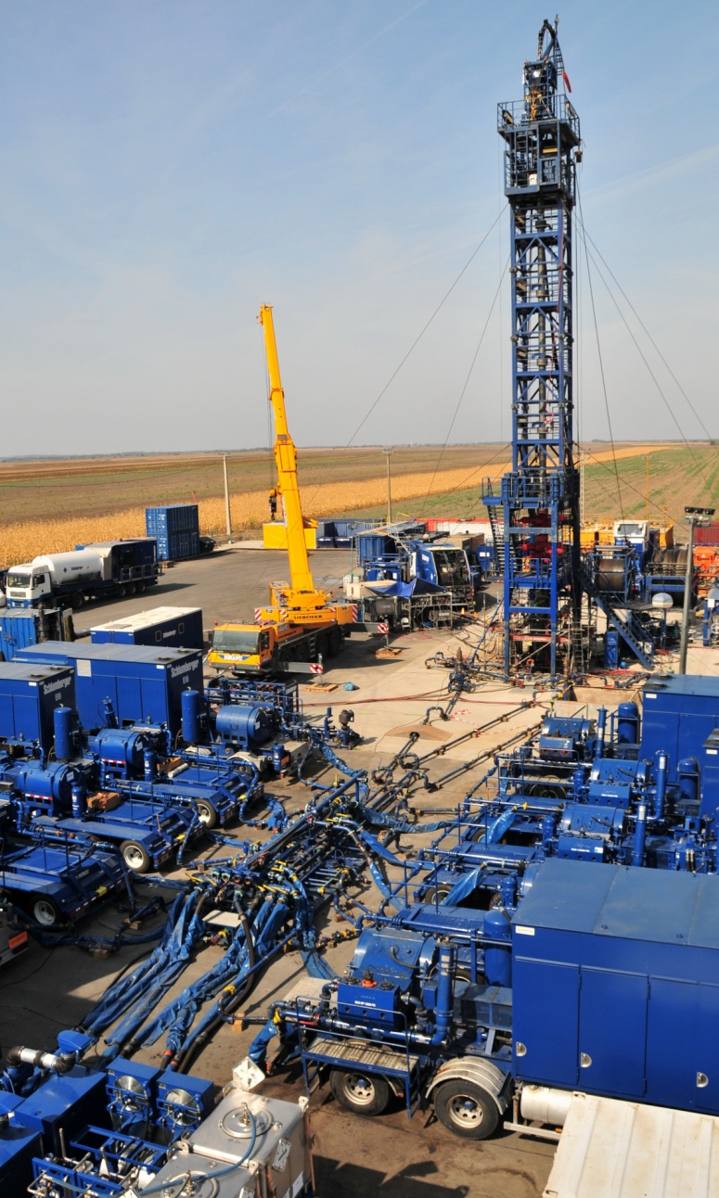
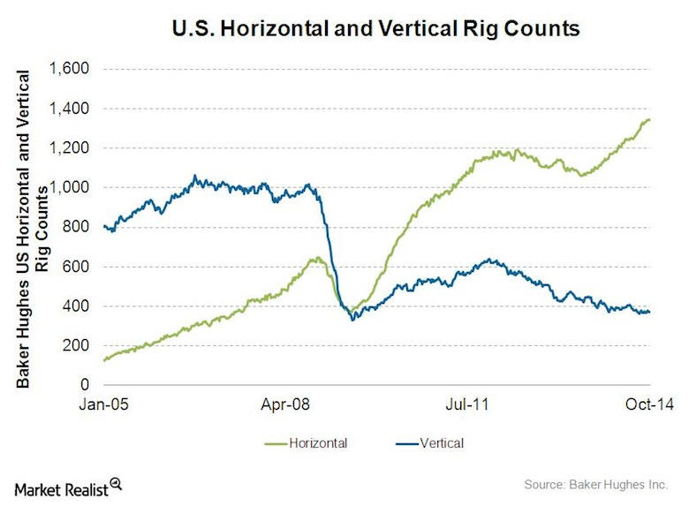
Unconventionals 101 - 'Conventional' technology
1957
US horizontal vs. vertical wells (BH, 2014)
Fracking has a long history...
Multi-well pad
2009
Multi-well pad in Szeged, Hungary

Slide 6
Where it works...
The US has experienced a dramatic increase in natural gas and oil production from unconventional resources
GAS
OIL
Source: US EIA, 2014

Slide 7
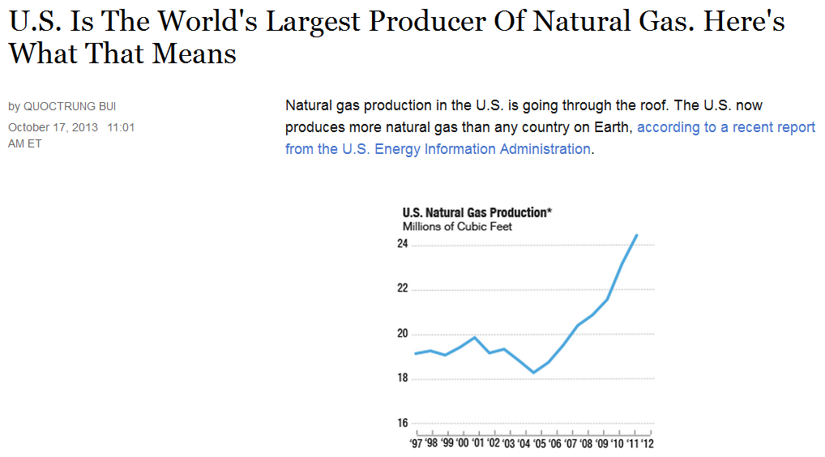
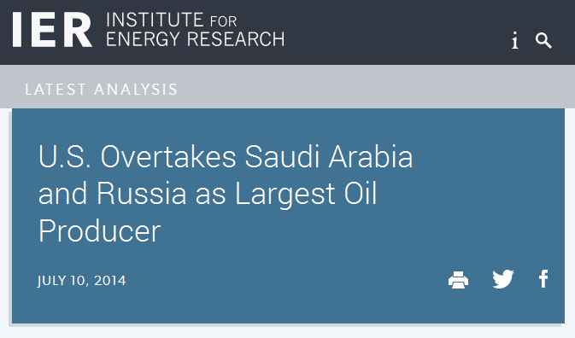
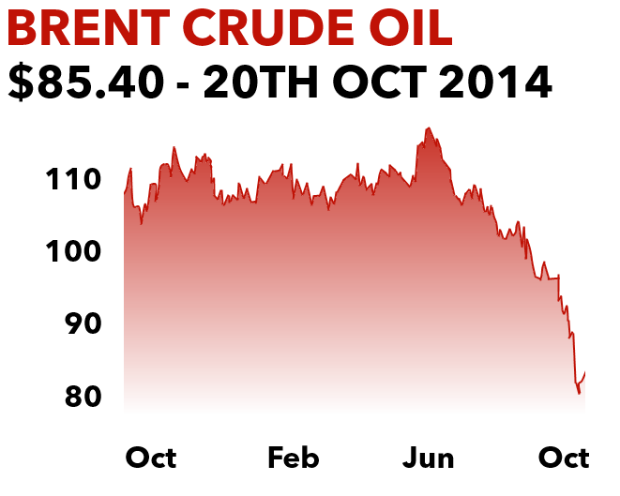
Where it works...
The US has become the largest oil and gas producer in the world recently overtaking Saudi Arabia and Russia
Unconventional 'revolution' gives major competitive advantage to US economy - recovery after 2008-09 crisis; energy security, feedstock supply, tax revenue, job market, etc.
Pressure mounts on the US government to lift the ban on US crude exports introduced in 1975 in response to the Arab oil embargo - impact on US foreign policy
Exports of refined petroleum products are not banned but soared
US oil exports can help stabilising world markets, current slump of oil prices - OPEC reaction, significant global impact

Slide 8
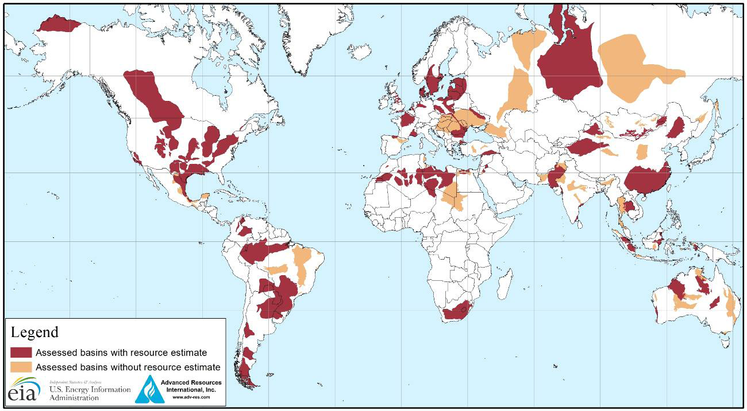
Where it may work...
?
Source: US EIA, 2013

Slide 9
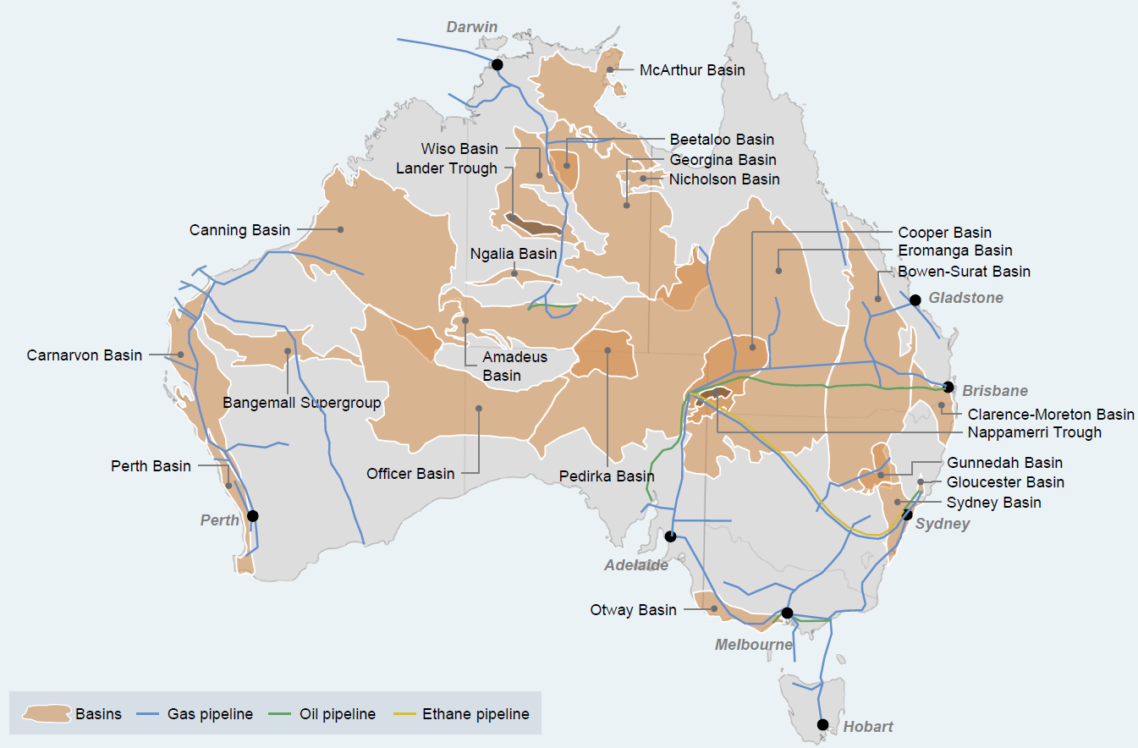
Unconventional E&P Arena Australia - Major Recent Farm-in Deals
Beetaloo Basin:
Origin & Sasol to invest $185M with Falcon
Beetaloo Basin:
Santos to invest $70M with Tamboran
Canning Basin:
Mitsubibishi to invest $102M with Buru Energy
Georgina Basin:
Statoil to invest $175M with PetroFrontier
Canning Basin:
ConocoPhilips to invest $120M with New Standard
Georgina Basin:
Total to invest $190M with Central Petroleum
Amadeus & Pedrika Basins:
Santos to invest $150M with Central Petroleum
Cooper Basin:
Santos to invest $120M with Drillsearch
Cooper Basin:
Chevron to invest $349M with Beach Energy
Cooper Basin:
BG to invest $130M with Drillsearch
Cooper Basin:
Oigin to invest over $200M with Senex
Over $2 billion spent on farm-in and corporate transactions in recent years
Various sources

Slide 10
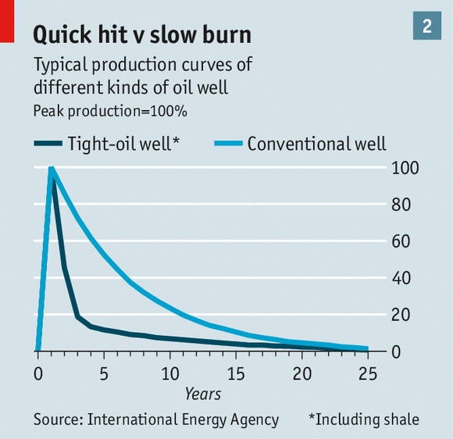
Technical challenges
No 'heureca' moment of discovery
Geological challenge: finding the sweet spots (= areas of increased storage and/or production potential)
Use of analogs is limited
Technological challenge: finding the frac recipe
Expensive wells, both drilling & completion
Frontloaded production profile of tight oil & gas wells
Rapid production decline: ~30% in case of unconventional vs ~5-10% in case of conventionals
A single well produces significantly less than in case of conventional
Maintaining production at 1 million barrels per day in the Bakken requires 2,500 new wells a year; a large conventional field in Iraq needs just 60

Slide 11
Be careful with analogs...
It’s just like the Barnett
Definitely an Eagleford
look-alike
Should be, er....
Marcellus
Surely a tight oil play...
Bakken perhaps?
Haynesville or I’m an elephant
Unconventional plays are unique
Cracking the code - recipe is shale specific
Will take much longer and be more expensive than expected
11

Slide 12
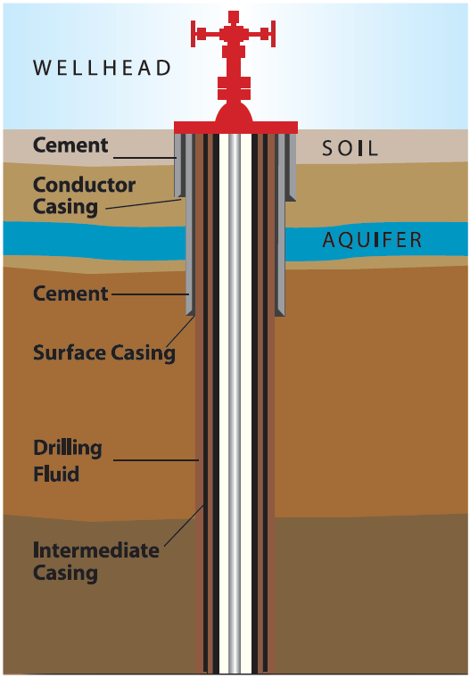
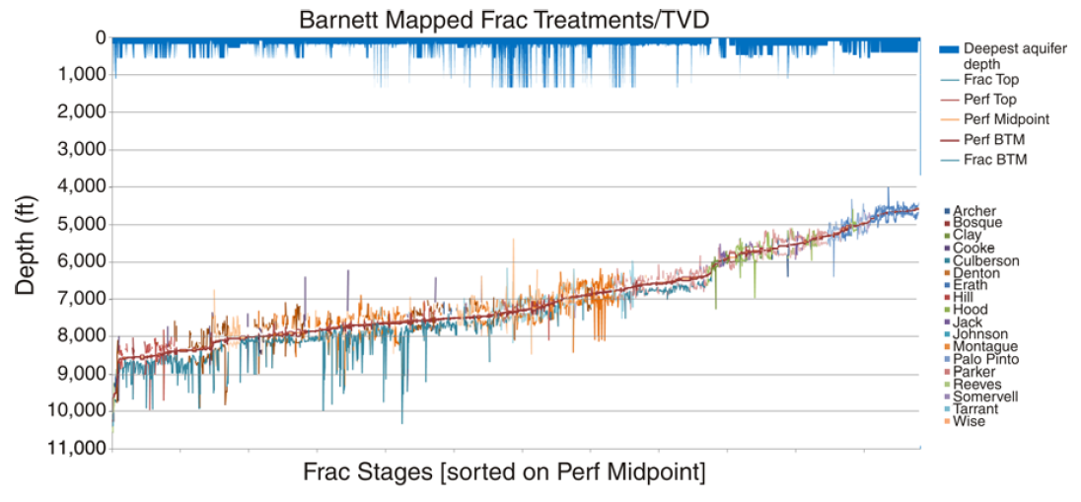
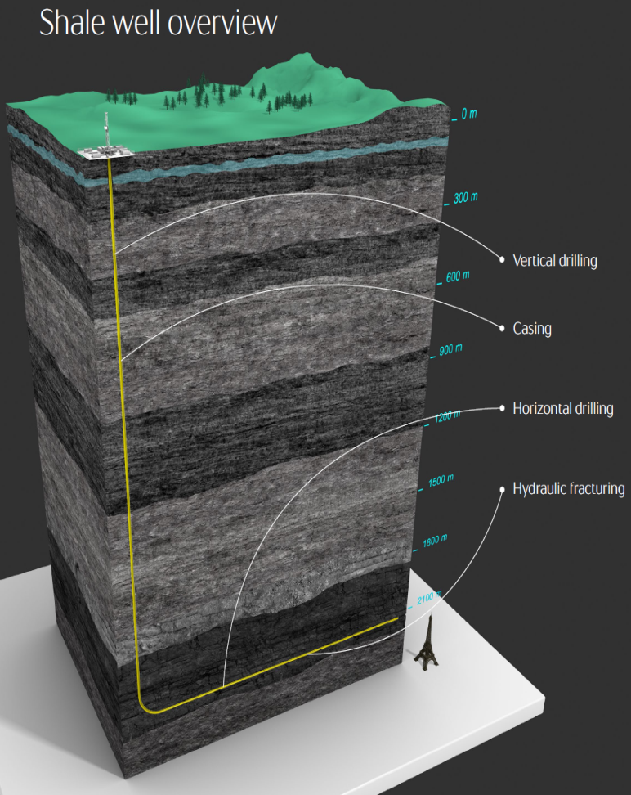
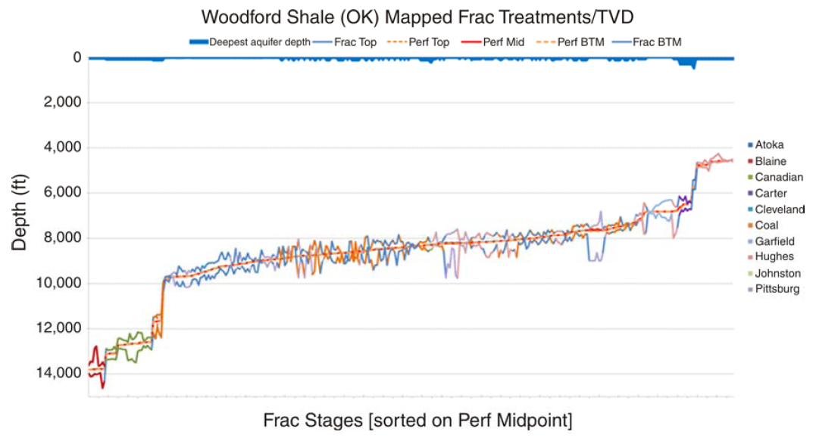
Environmental challenges - Local concern: Water contamination
Shale gas
Aquifer
Frac depth
API, 2014
Aquifer
Shale oil
Aquifer
1,000 - 5,000 m
Frac depth
Frac
Statoil, 2013
Fischer & Warpinski, 2011

Slide 13
Environmental challenges - Local concern: Water contamination (cont.)
Chemicals used in current fracking operations are non-toxic
All chemicals must be permitted and disclosed
Transparency is key in keeping credibility & obtaining public trust
API, 2014

Slide 14
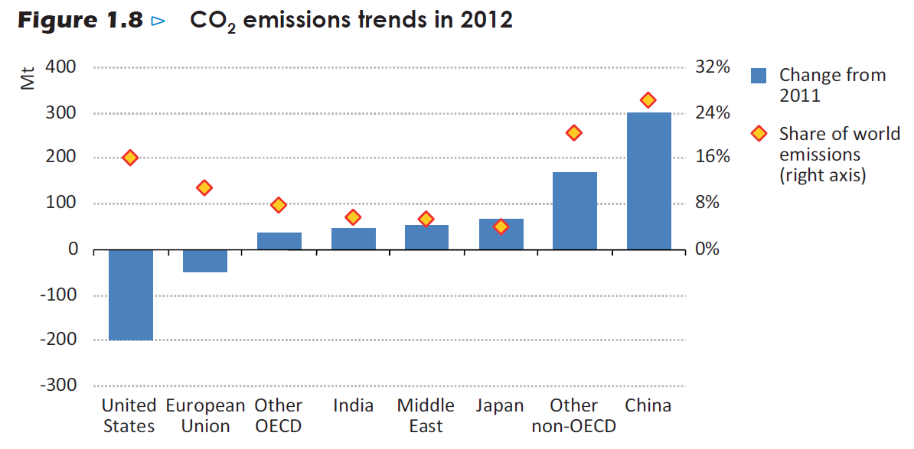
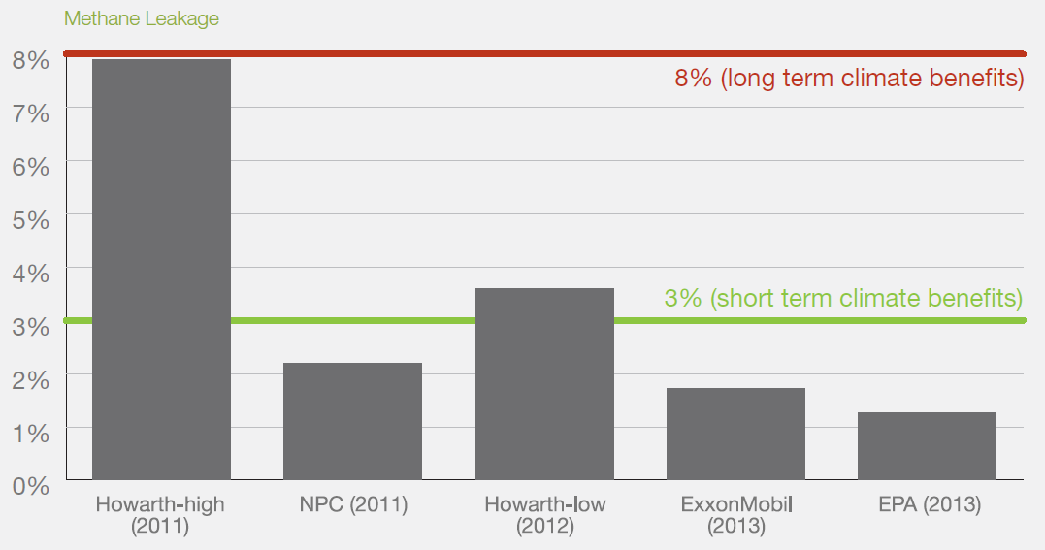
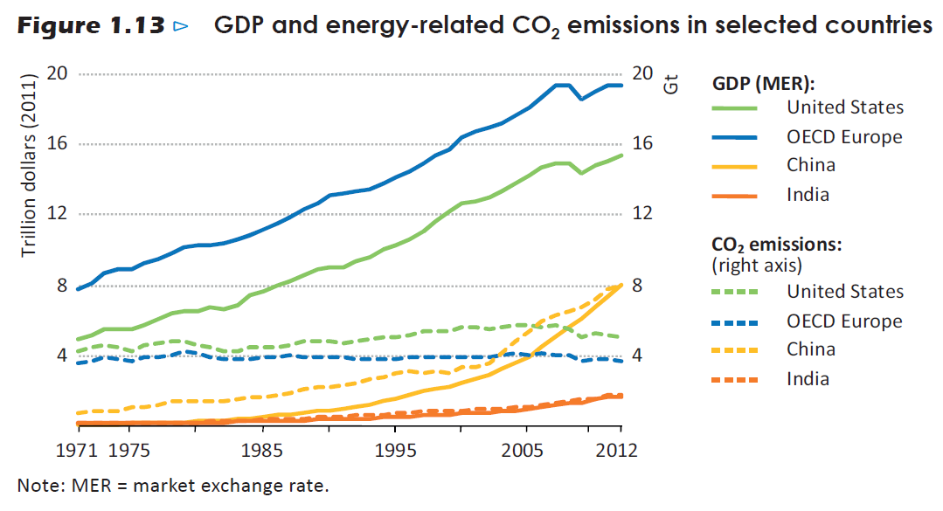
Environmental challenges - Global concern: Climate change
Methane leakage rate estimates for gas systems in US
~29% of US methane emission comes from CH industry
Decrease in CO2 emissions in the US mainly related to shift from coal to shale gas (and better energy efficiency)
Decrease in CO2 emissions in the EU mainly related to advances in alternatives (and better energy efficiency)
Source: US International Energy Agency, 2013 - Redrawing the energy-climate map

Slide 15
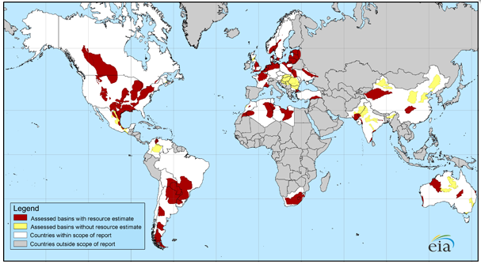
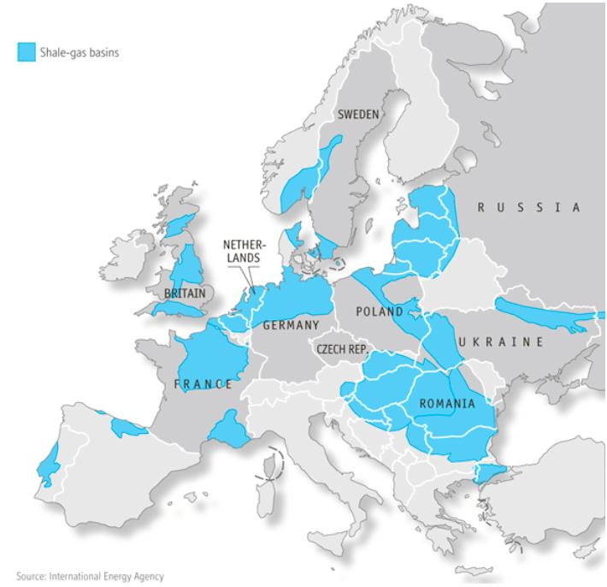
The European context - The quest for gas
???
Environment
Economic benefit
U.S. EIA (2013) reported
470 TCF recoverable shale gas resources for Europe
and 664 TCF for the US
Size of resources is comparable
Activities are in early exploration stage
No commercial production yet
Will the impact be similar?!
Industry - geology, technology, services, etc.
Commerciality - development costs, gas market
Environmental & regulatory issues, politics

Slide 16
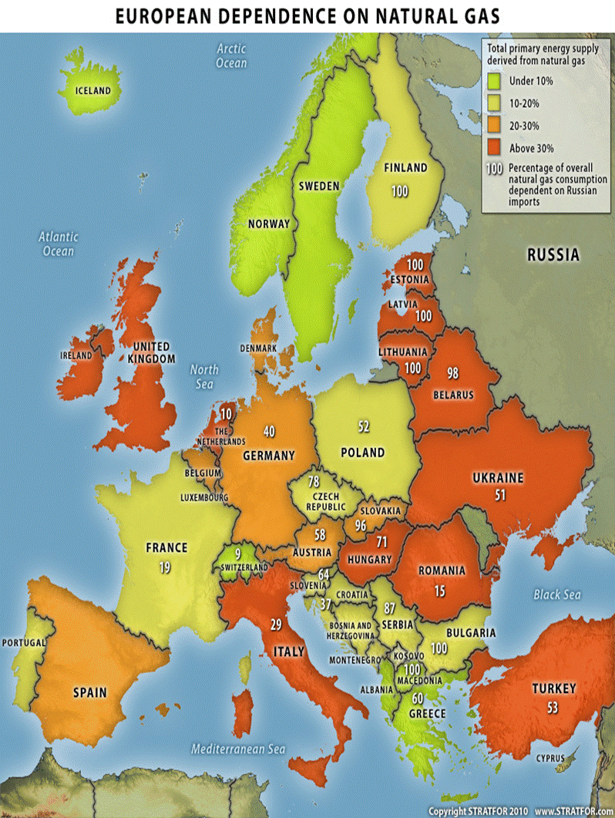
The European context - The quest for gas
European dependence on gas vs. unconventional potential

Slide 17
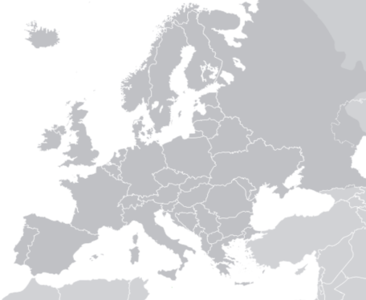
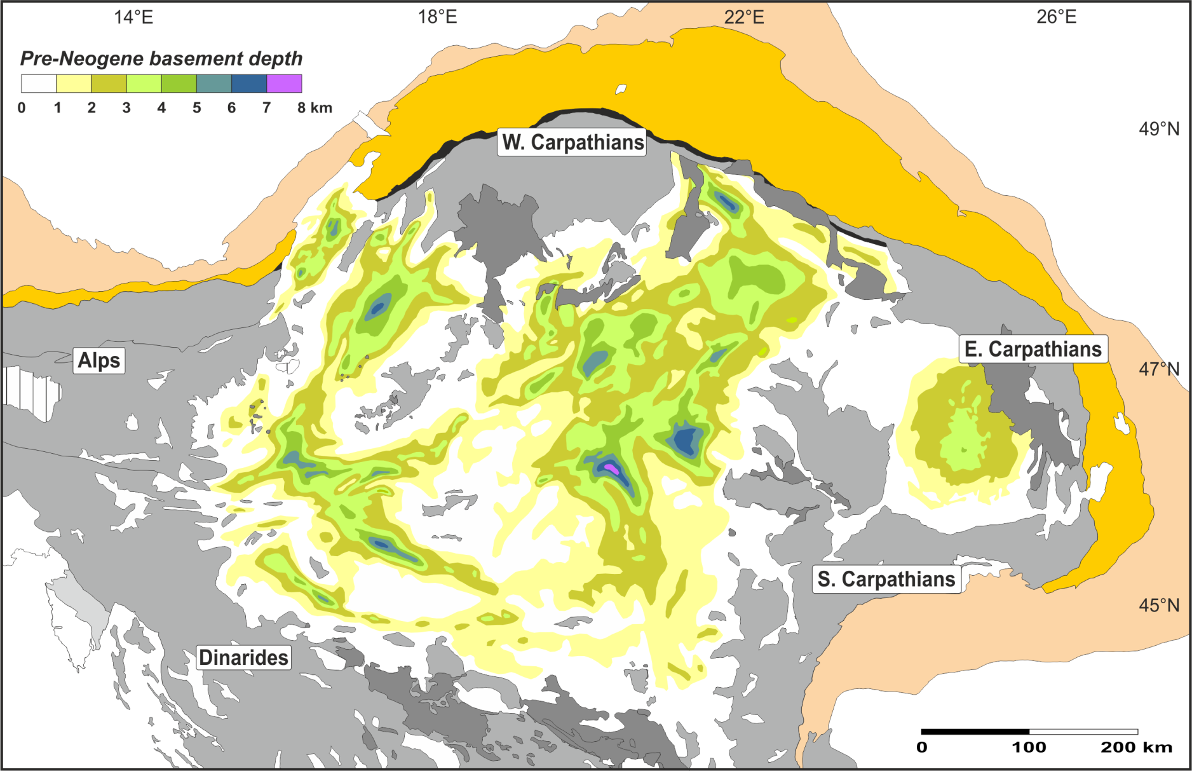
Pannonian basin - Key players in unconventional exploration
Nafta
OMV
MOL
Cuadrilla/RAG
HHE/Aspect
Ascent
TXM/Falcon
MOL/INA
NIS

Slide 18
How it all started in Hungary
John Gustavson's main original criteria (late 90's)
The concept of Basin Centered Gas Accumulation or BCGA
“If you’re looking for deep basin centered gas…..
its good to look in deep basin centers”
18

Slide 19
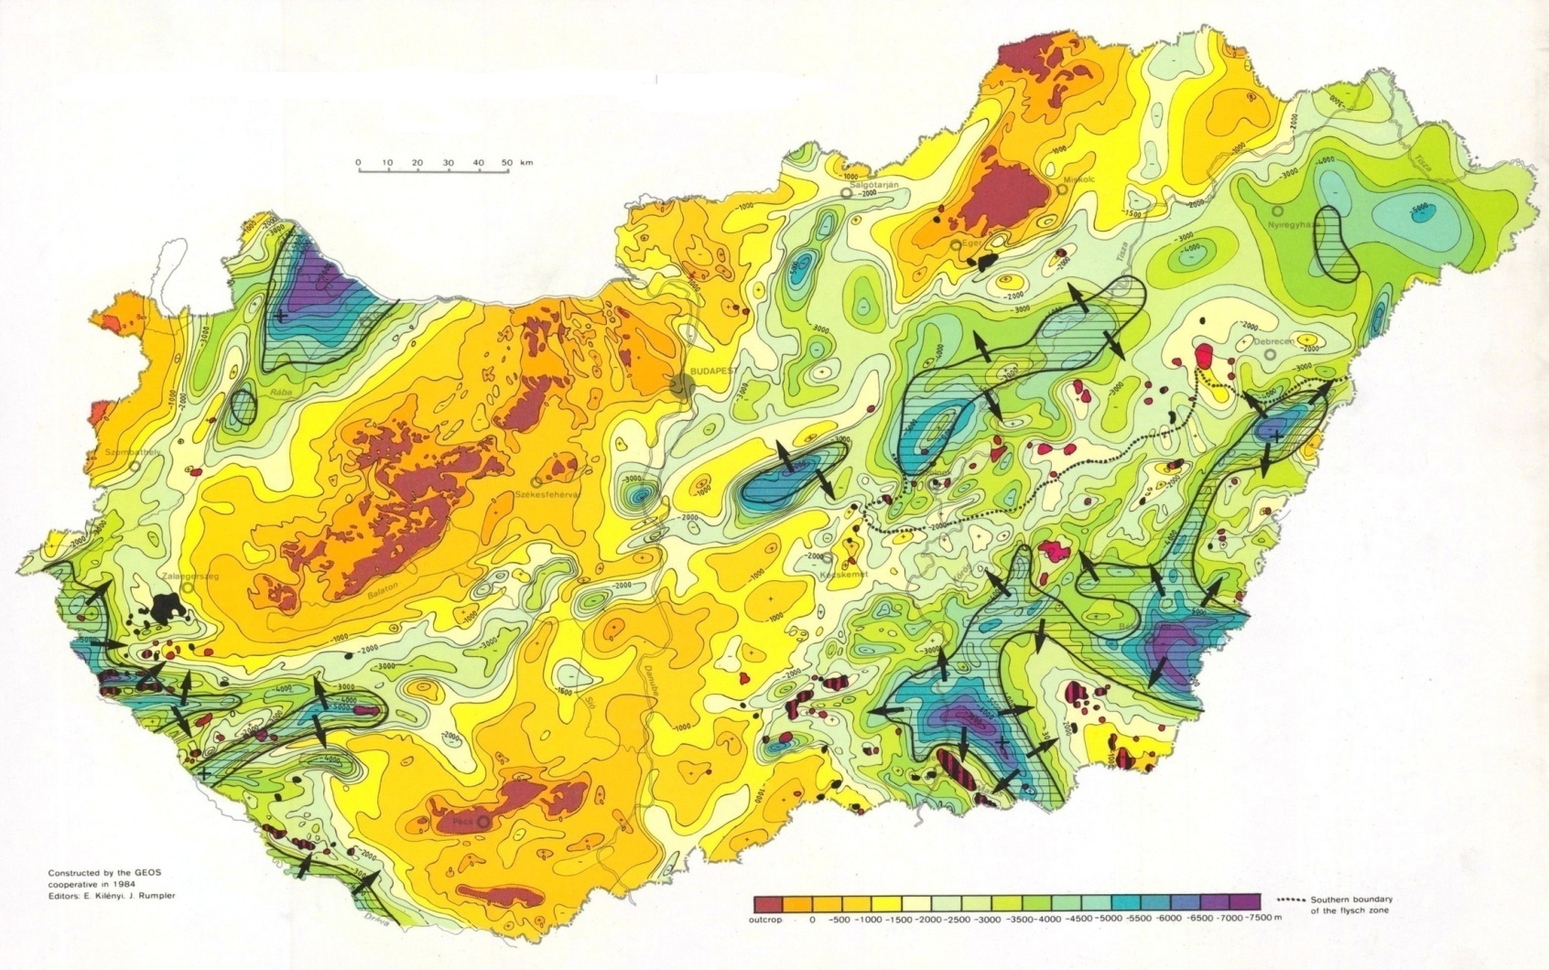
How it all started in Hungary
Basement depth & Neogene-Quaternary sediment thickness in Hungary
Makó Exploration
Area
Kilényi & Rumpler, 1984
19
Notes:
19

Slide 20
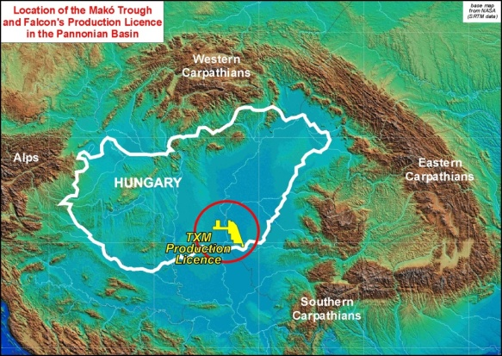
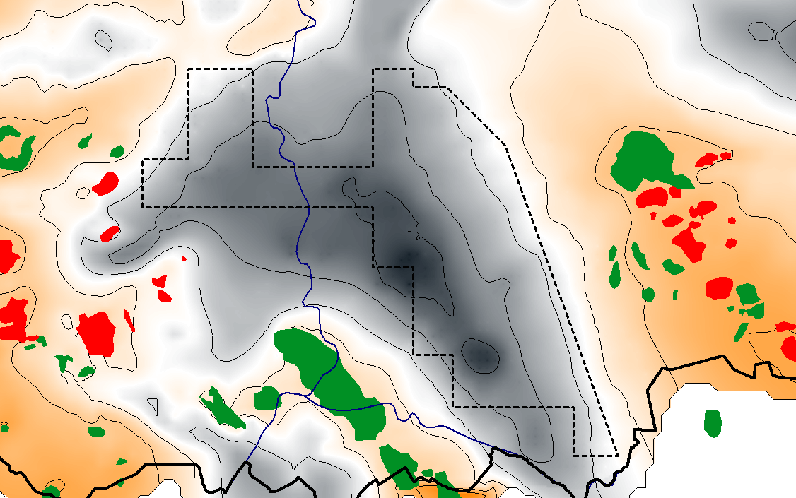
Main oil and gas fields around the Makó Trough
Békés basin
TXM Mining Plot
Szank
Pusztaföldvár
Csólyospálos
Algyő field
production:
220 MMBO,
2.6 TCF gas
Pusztaszőlős
Tótkomlós Végegyháza Kaszaper
Makó trough
Kiskunmajsa
Mezőhegyes
Üllés
ALGYŐ
Battonya
Pusztaföldvár-
Battonya
high
Kiskundorozsma
Ferencszállás
Szeged basin
Algyő high
20

Slide 21
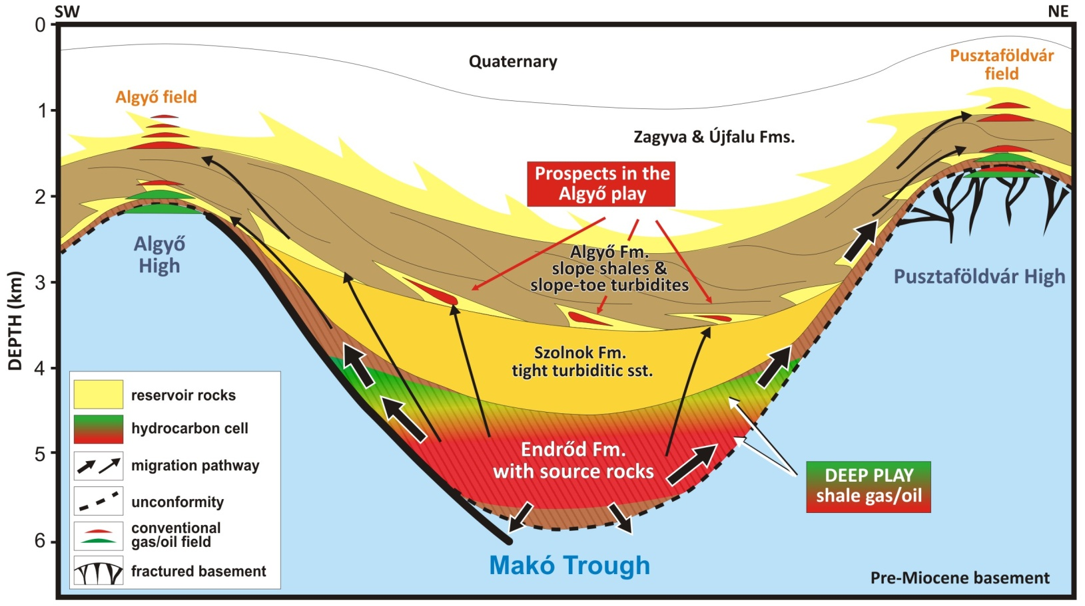
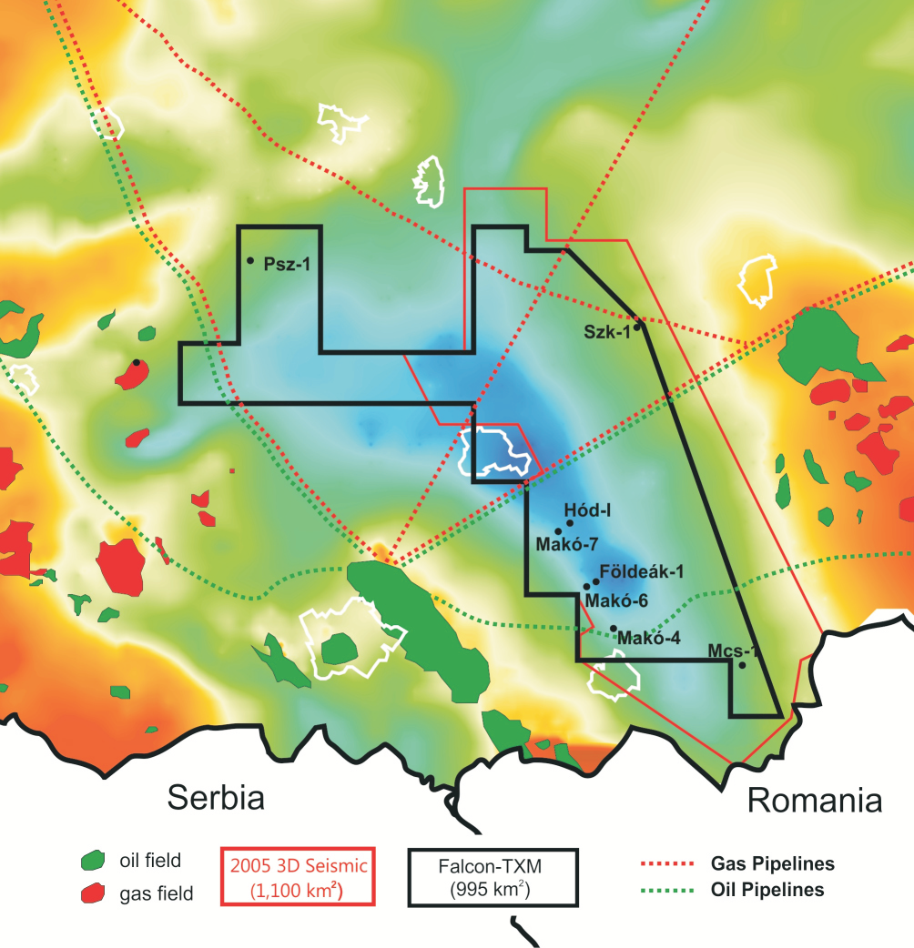
After more than a decade of Falcon's efforts...
100% interest in 995 km2 35-year Production Licence granted in 2007
Early exploration efforts focused on proving hydrocarbon potential and delineation of basin
6 wells drilled by Falcon alone, 3 wells drilled in partnership (Exxon, NIS) - total expenditure over $300M
Wells encountered thick sequence of hydrocarbon bearing rocks; tests flowed hydrocarbons from tested horizons
Code is not yet cracked in the Makó Trough - nor in anywhere else in the Pannonian basin
Shallow Play
Algyö
Deep Play

Slide 22
Lessons learnt & key issues
North America has seen a remarkable 'revolution' with the development of unconventional hydrocarbon resources. Major impact on world oil and gas.
'Global' understanding of unconventional resources is still in its infancy. Use of analogs, albeit helpful, is limited. Surprises will surely come.
Success story cannot be carbon copied - it will take longer and more expensive than expected. Early gathering of data is very costly but very informative. Local experience and wealth of data accumulated are key to success.
Several unconventional play types (shale gas & oil, tight gas) are present in the Pannonian basin largely contributes to the remaining petroleum potential of Hungary. Future of exploration and success of exploration projects in this mature area strongly depend on bringing new G&G, reservoir and production technologies.
Environmental aspects of unconventional exploration and production cannot and should not be ignored. Do it right from the beginning because it’s right. Monitor everything - before, during and after.
Engagement to the public, local communities & authorities is critical. Listen and communicate: it is not just PR!

