Slide 1
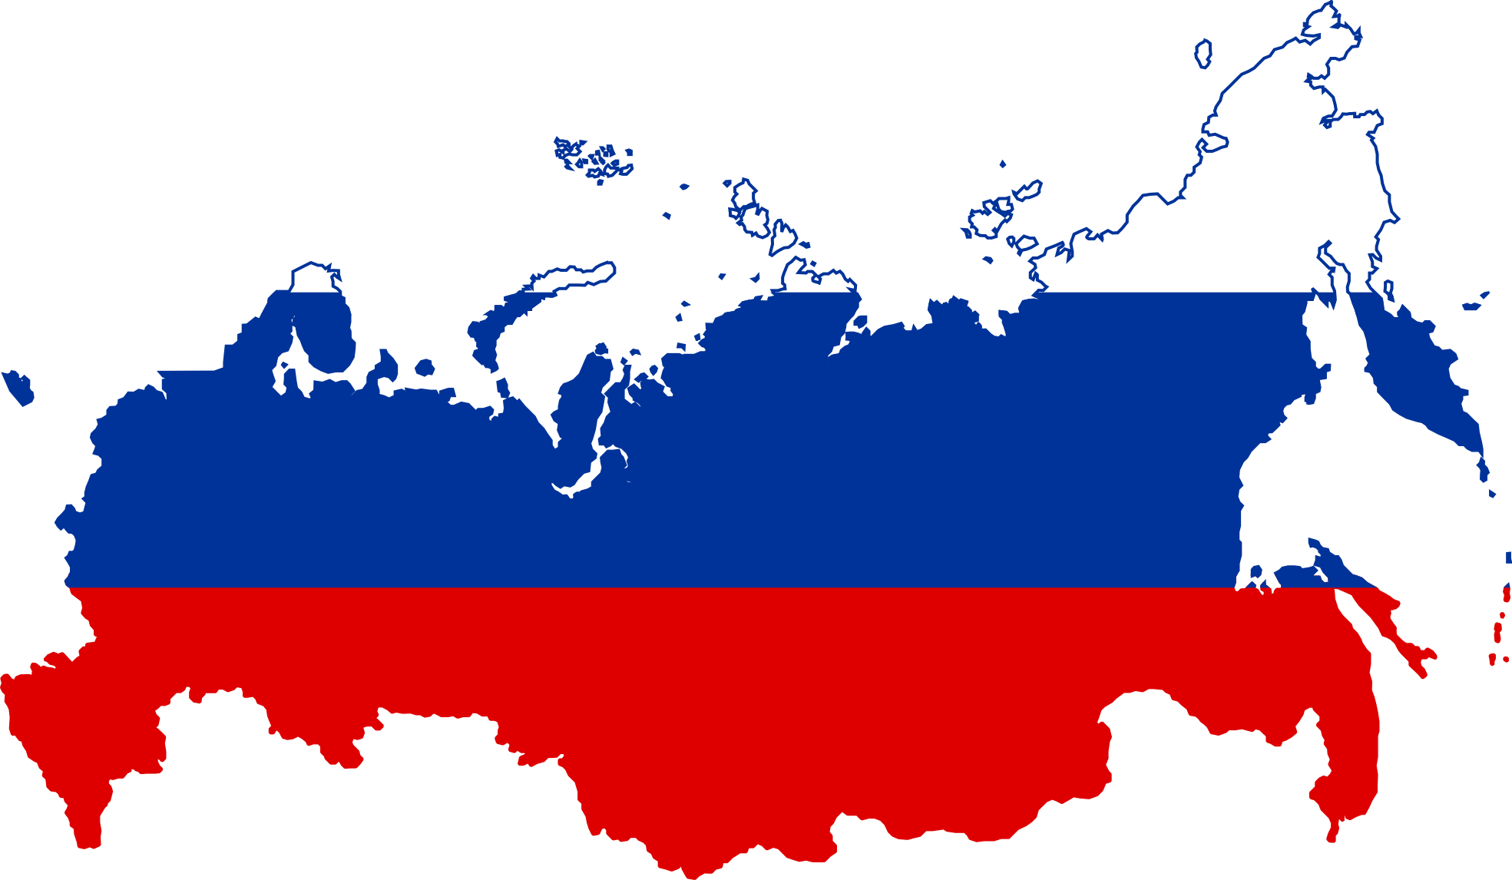
RUSSIAN NATURAL GAS UPSTREAM AND THE EFFECTS ON EUROPEAN GAS MARKETS

Slide 2
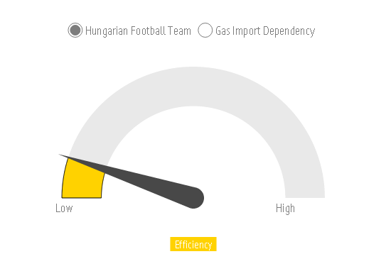
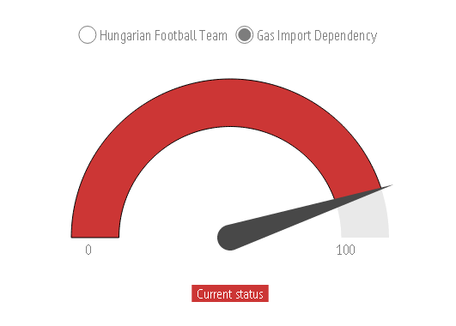
Correlation?

Slide 3
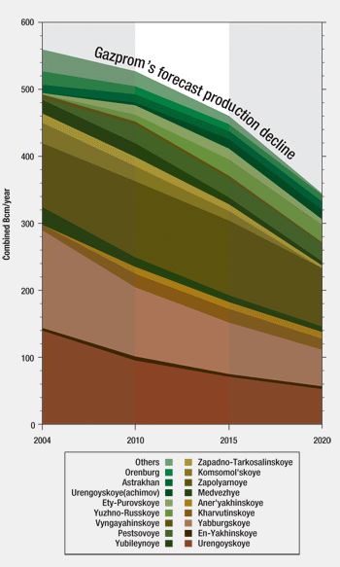
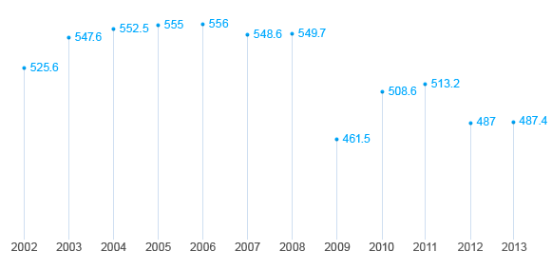
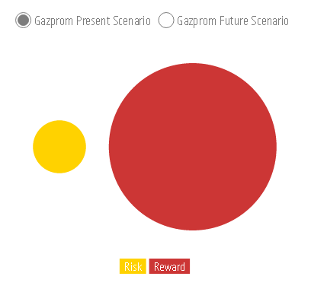
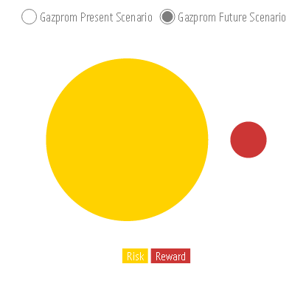
Production
Playing a low risk – high reward game, instead of high risk – high reward, will result in a high risk – low reward outcome.
Russian gas upstream
Slow and expensive upstream projects
Slow and ineffective noc’s
Lack of new technologies
Lack of market liberalization
Sanctions

Slide 4
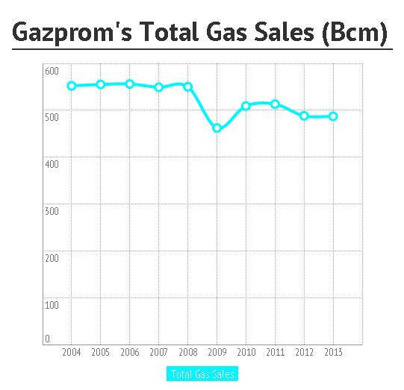
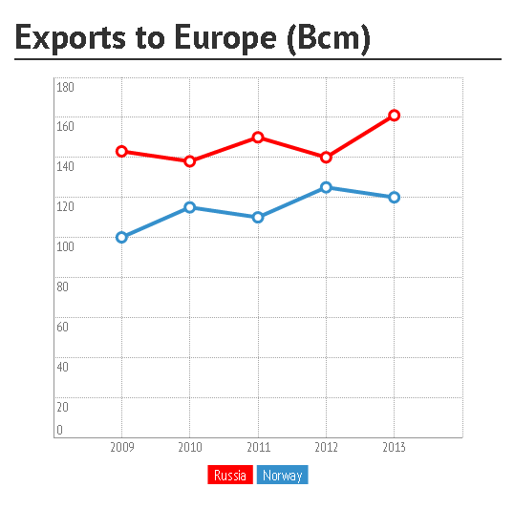
Exports
The diminishing of export markets, as a result of decreasing volumes, fluctuating prices, LTC, OPI and political uncertainties, will continue in the future.
Russian gas upstream

Slide 5
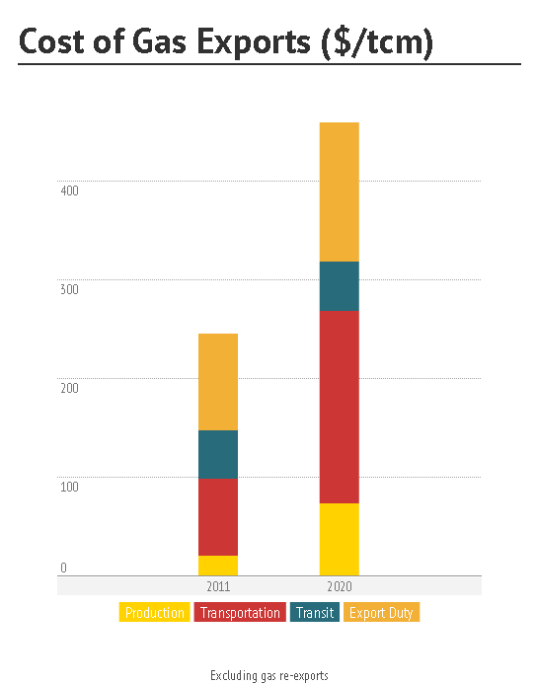
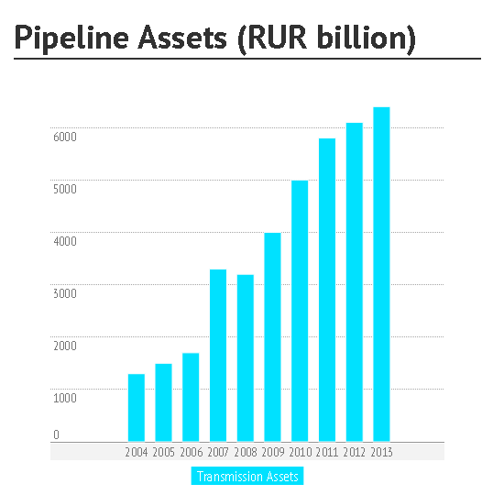
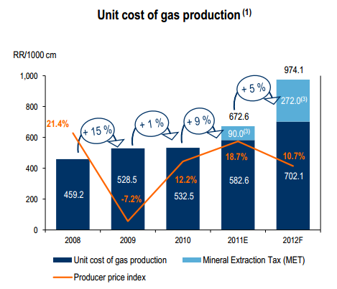
Transportation costs
Production and transportation costs will triple by the end of the decade. As a result Gazprom will face less revenue and more cash flow problems.
Russian gas upstream

Slide 6
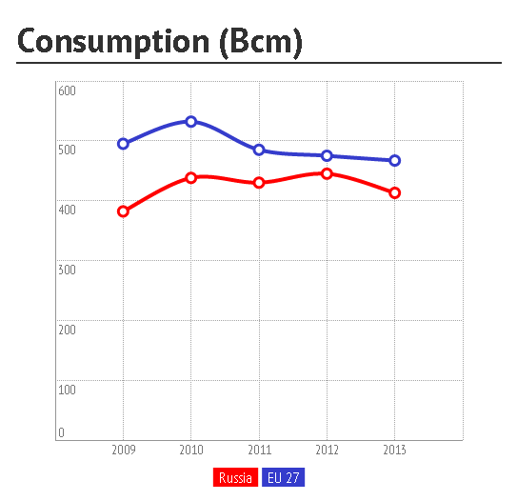
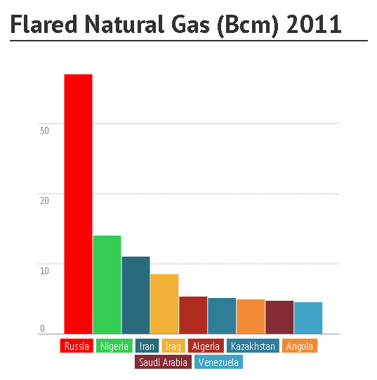
consumption
140 million Russians are nearly consuming as much natural gas, as 500 million Europeans. If Russia does not want to fall into the export country trap, then needs to institute a mega energy efficiency program.
Russian gas upstream

Slide 7
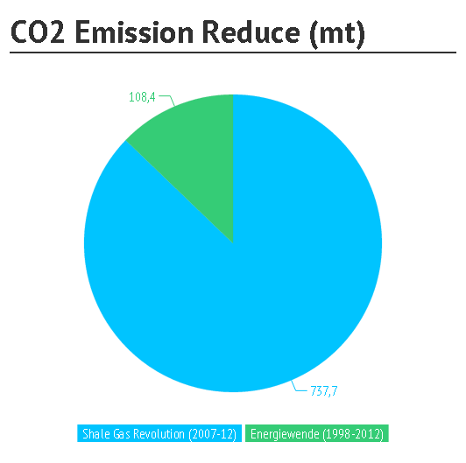
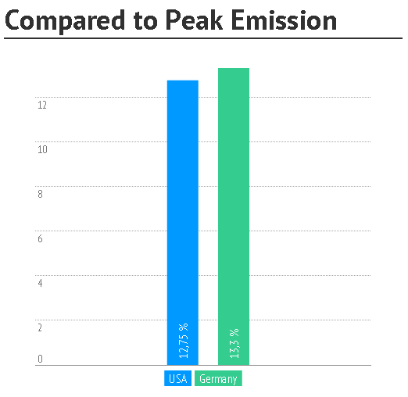
Natural gas as a smoothing fuel
Russian gas upstream

Slide 8
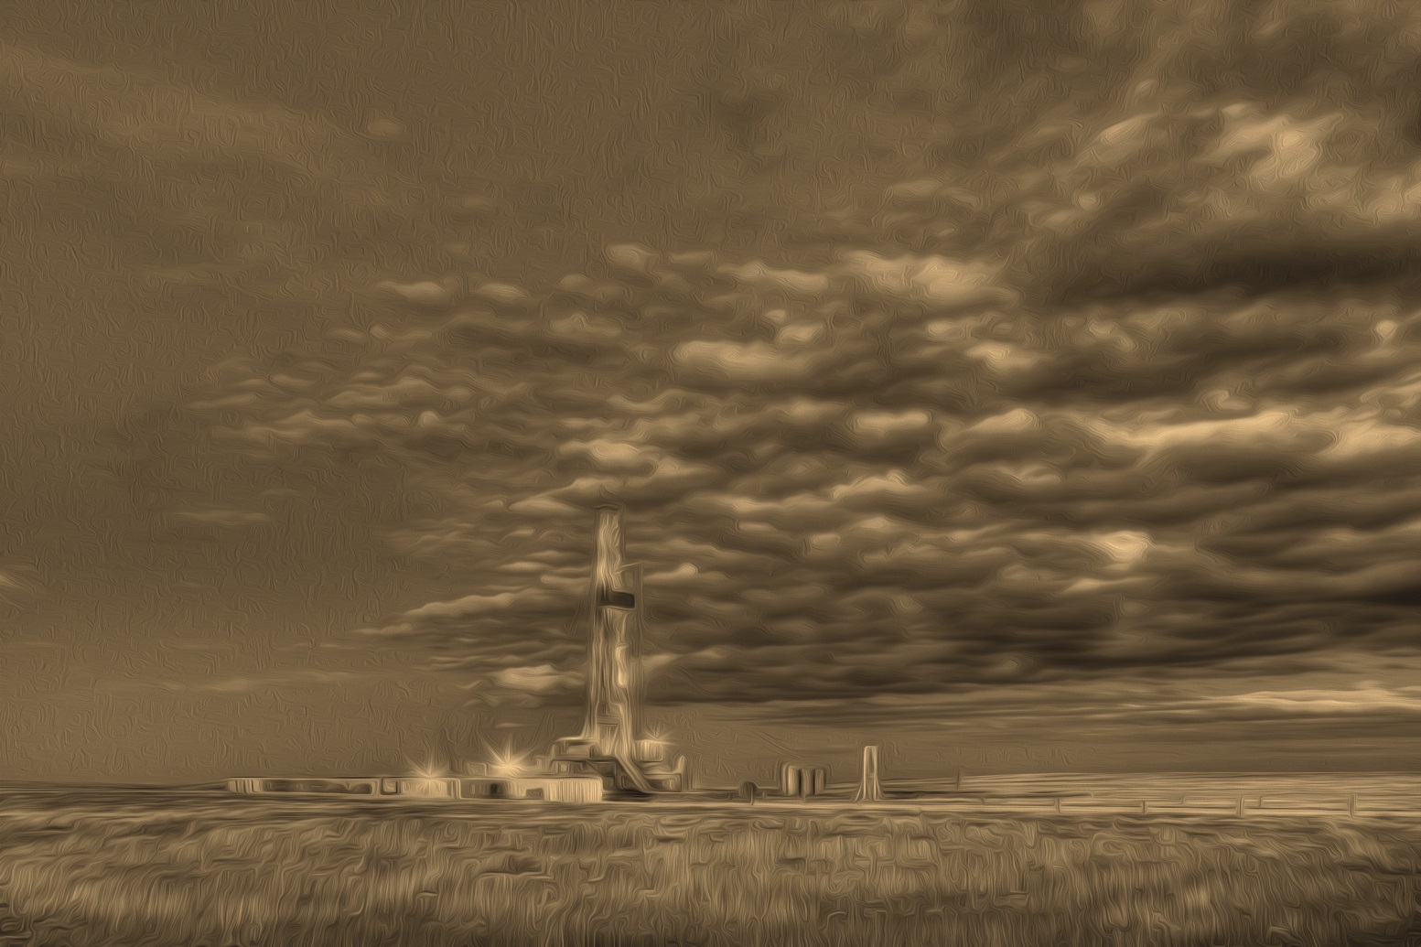
Thank you for your attention

